Slide 1
Budgetary Affairs Committee
Oct 22, 2020
Referrals
Scholarship discount rate
Committee internal: ID card readers, Kummer Institute
Continuing referrals:
Report on the “big picture balance sheet”
Current and next FY budget

Slide 2
COVID money (ID card readers)
Financial target for each campus, items decided by System committee including two S&T finance employees
Funds = reimbursement for costs not originally budgeted
Limiting access to labs (and conference rooms) seen as critical in March
Document how many in room to avoid exceeding COVID limits
Also funding conference room equipment

Slide 3
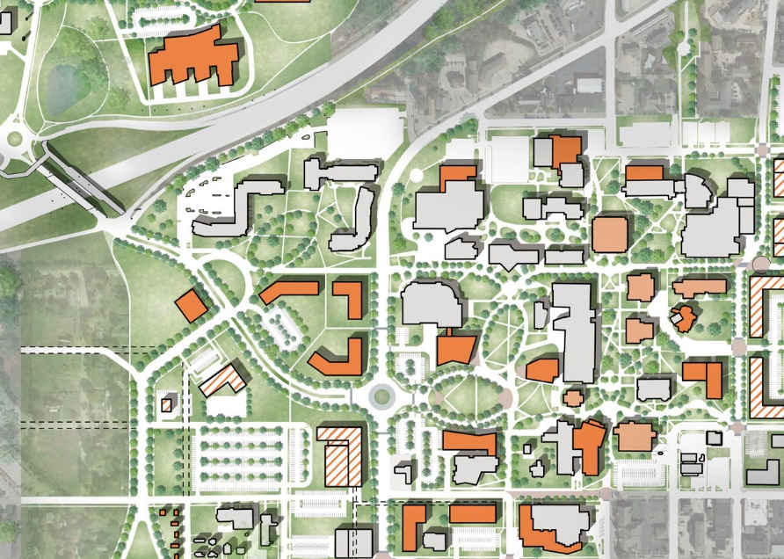
Kummer Institute Foundation (numbers approx.)
$430 MM Proposal
$300 MM gift (stock transferred)
$225 MM endowment
$75 MM
Institute director
Straumanis-James/ERL Addition
Student Experience Center
Systems Integration and Prototype Development Facility
$10 MM annual
Scholarships, fellowships
Research centers
Online degree expansion
Lecture series
Shuttle service
20 faculty (salary) ~ $2 – 3 MM

Slide 4
Kummer Institute Foundation (numbers approx.)
$430 MM Proposal
$300 MM gift (stock transferred)
$225 MM endowment
$75 MM
Institute director
Straumanis-James/ERL Addition
Student Experience Center
Systems Integration and Prototype Development Facility
$10 MM annual
Scholarships, fellowships
Research centers
Online degree expansion
Lecture series
Shuttle service
20 faculty (salary) ~ $2 – 3 MM
General operating budget
$1-1.5 MM benefit cost
$1.5 MM operating cost (2%)
$2-3 MM cut needed

Slide 5
Welcome Center & Entryway
Not Kummer Institute
$10 MM, VC Plain has pledged part

Slide 6
All Funds Budget: revenue
$8 MM accounting change nets zero, but
$4 MM increase in scholarship costs
 | FY19 | FY20 | FY21 (budgeted)
Tuition and Fees | $134,602,696 | $130,456,684 | $123,806,127
Scholarship Allowance | (52,410,261) | (64,966,612) | (62,236,470)
Net Tuition & Fees | $82,192,434 | $65,490,072 | $61,569,657
State Appropriation | 50,185,510 | 43,543,499 | 43,560,524
Grant and Contract | 40,338,895 | 48,105,314 | 48,902,000
Gift Revenues | 7,522,979 | 3,031,199 | 6,164,295
Recovery of F & A | 14,039 | 430 | 0
Endowment & Investment Income | 9,326,040 | 9,604,262 | 9,082,208
Sales & Services Income | 21,769,025 | 17,634,555 | 19,141,165
Other Incomes | 4,619,518 | 8,414,083 | 4,497,816
Revenue Contingency | - | - | (938,512)
Total Revenues | $215,968,442 | $195,823,416 | $191,979,152
$6.6 MM drop
$2.7 MM lower cost
Fear of withholding
$1.5 MM rebound estimated
Internal withhold
$3.85 MM cut
$11.7 MM cut planned,
where’s $7.85 MM?
$4 MM decrease = sent home (dorms, dining)

Slide 7
All Funds Budget: costs
Total Revenues | $215,968,442 | $195,823,416 | $191,979,152
Transfers | FY19 | FY20 | FY21 (budgeted)
Intra Unrestricted CurrentFund | $968,016 | $4,220,348 | $106,060
Mandatory Transfers | (10,718,936) | (11,384,016) | (11,559,318)
NonMandatory Transfers | (14,361,580) | (10,630,586) | (413,847)
Total Transfers | ($24,112,501) | ($17,794,253) | ($11,867,106)
Expenditures
Salaries & Wages | $106,061,187 | $102,581,750 | $99,824,540
Benefit Expense | 30,532,226 | 30,384,639 | 32,000,257
Compensation | $136,593,413 | $132,966,389 | $131,824,796
Other_Expenses | 57,209,262 | 47,944,226 | 47,340,424
Total Expenditures | $193,802,675 | $180,910,615 | $179,165,220
Total Expenditures + Transfers | $217,915,176 | $198,704,868 | $191,032,326
Paying loans on dorms, geothermal, Bertelsmeyer
$2.76 MM cut
Benefit cost growth, layoff costs
$0.94 MM ‘withhold’

Slide 8
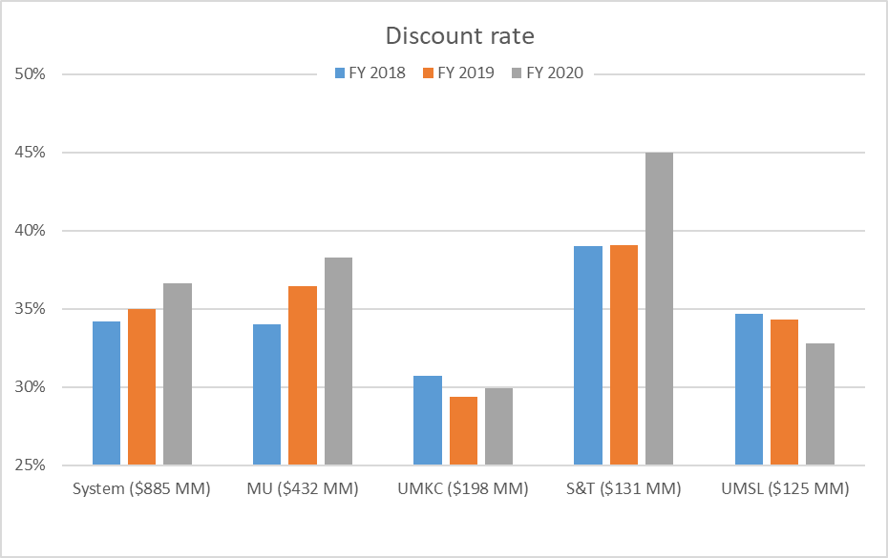
Tuition discount rate comparison
Proportionally more students receive
Merit-based scholarships
Need-based scholarships
Financial aid strategies: developed by Enrollment Mgt with assistance from consultants, CFO/Provost/Chancellor review and approve.
Data: Budget Book, UM System 2020 Budget
Uses different ‘all funds’ than past slides

